Slide 1
Long-Tailed Classification by Keeping the Good and Removing the Bad Momentum Causal Effect
Kaihua Tang¹, Jianqiang Huang^{1,2}, Hanwang Zhang¹
¹Nanyang Technological University
²Damo Academy, Alibaba Group
Github: https://github.com/KaihuaTang/Long-Tailed-Recognition.pytorch

Slide 2
Contents
Long-Tailed Classification
Related Work
The Proposed Causal Graph
De-confound TDE
Advantages
Experiments
Notes:
First

Slide 3
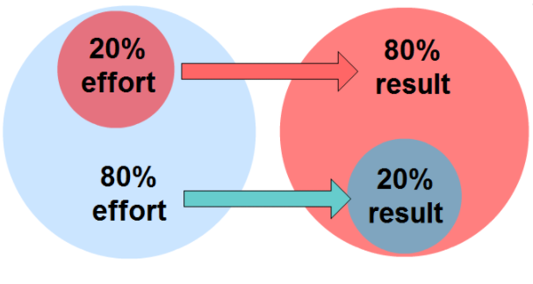
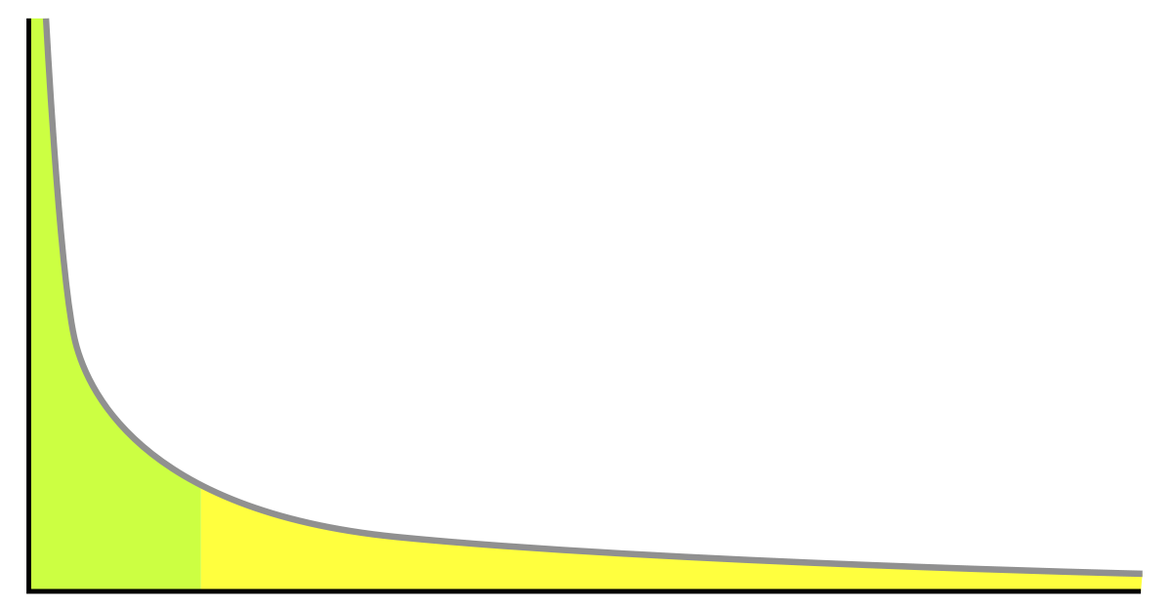
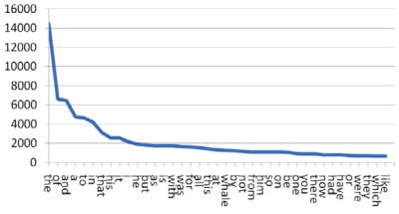

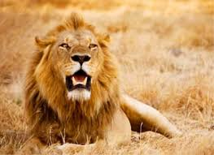
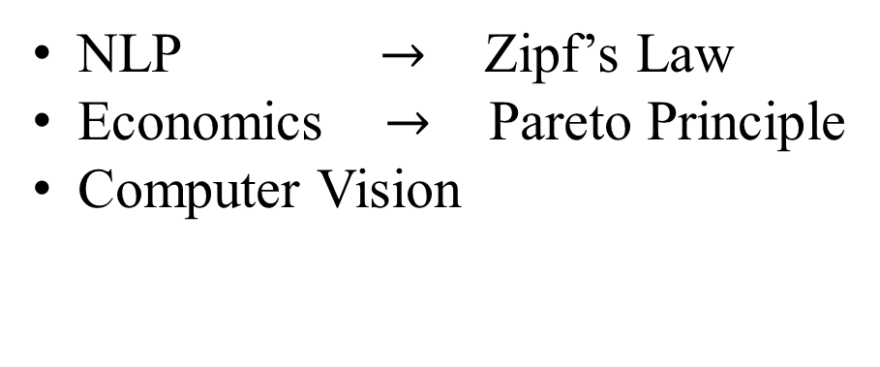
Long-Tailed Distribution
What is long-tailed distribution?
NLP $→$ Zipf’s Law
Economics $→$ Pareto Principle
Computer Vision
Number of Instances
Head Classes
(Most of the data)
Tail Classes (Most of the categories)
Categories Ranking by Frequency
Notes:
What is lt…
It’s a ubiquitous unbalanced distribution in all kinds of data

Slide 4
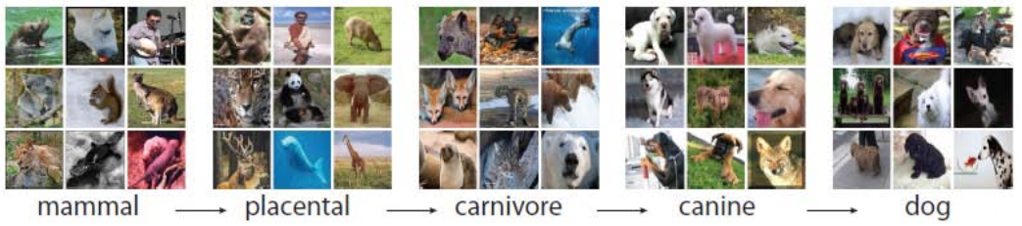
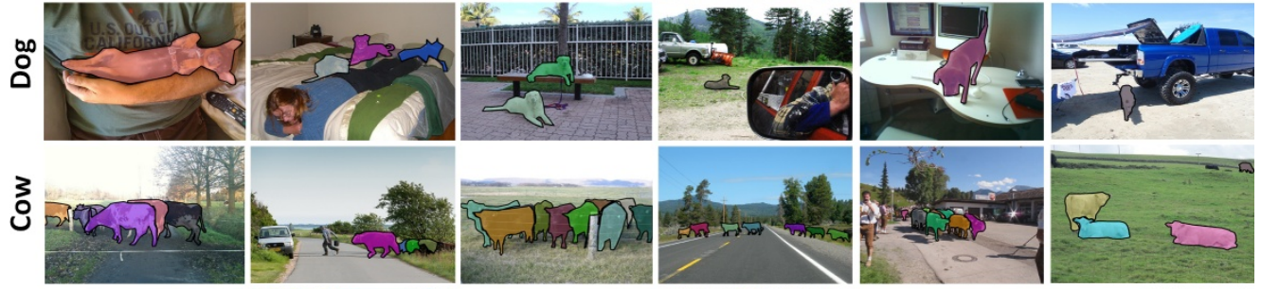
Long-Tailed Distribution
Why we never heard about long tail problem in ML before?
ImageNet (Image Classification)
MS-COCO (Object Detection & Instance Segmentation)
[1] Deng, Jia, et al. "Imagenet: A large-scale hierarchical image database." 2009 IEEE CVPR. 2009.
[2] Lin, Tsung-Yi, et al. "Microsoft coco: Common objects in context." ECCV. Springer, Cham, 2014.

Slide 5
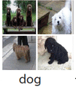

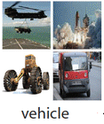
Long-Tailed Distribution
Why we never heard about long tail problem in ML before?
It’s because the dataset we saw has already been balanced by the pre-processing in the data collection stage.
ImageNet / MS-COCO
Collected
Raw Data
Pre-Processing
Balanced Data

Slide 6
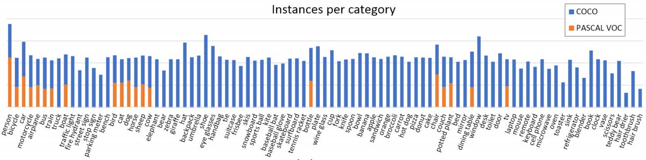
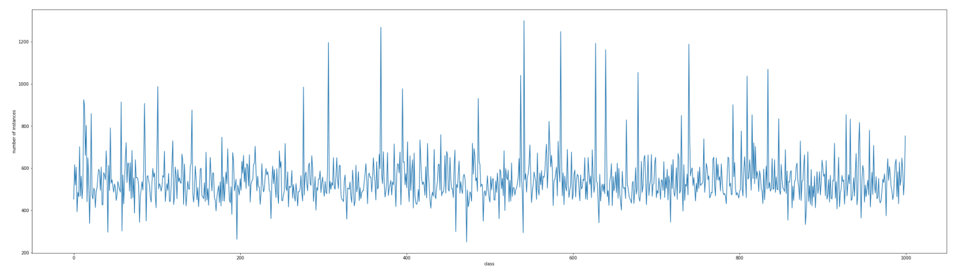
Long-Tailed Distribution
Why we never heard about long tail problem in ML before?
MS-COCO (Object Detection & Instance Segmentation)
ImageNet (Image Classification)
Instances per category
[1] Deng, Jia, et al. "Imagenet: A large-scale hierarchical image database." 2009 IEEE CVPR. 2009.
[2] Lin, Tsung-Yi, et al. "Microsoft coco: Common objects in context." ECCV. Springer, Cham, 2014.

Slide 7
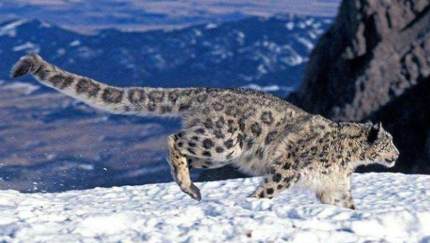
Limitations of Balanced Datasets
Question 1: What’s the problem of balancing all the dataset?
Data Frequency in Real-World
Data Collection Cost Per Instance
Head Classes
(Most of the data)
Most of the cost
Snow Leopard
Tail Classes
(Most of the categories)
Most of the category

Slide 8
Problems of Long-Tailed Datasets
Question 2: Why not directly use the long-tailed dataset?
Head Classes
(Most of the data)
Tail Classes (Most of the categories)

Slide 9
Long-Tailed Classification
The Problem of Long-Tailed Datasets
Head Class (1K)
Tail Class (10)

Slide 10
Long-Tailed Classification
The Target of Long-Tailed Classification
Head Class
Tail Class

Slide 11
Contents
Long-Tailed Classification
Related Work
The Proposed Causal Graph
De-confound TDE
Advantages
Experiments
Notes:
In previous work

Slide 12
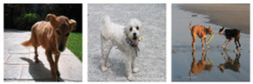
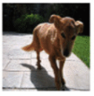
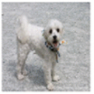
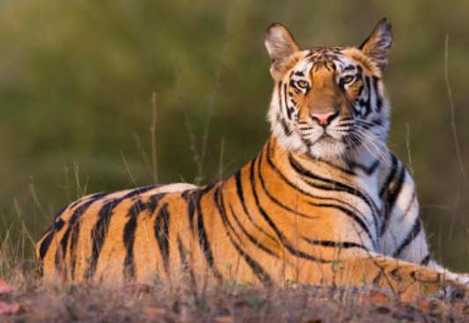
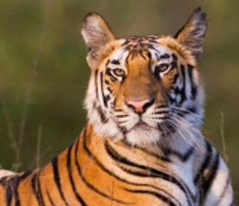
Re-balancing (Re-sampling/Re-weighting)
The most common solutions:
Re-sampling
Re-weighting
Head Categories
CNN Model
Re-sampling
Train
Tail Categories

Slide 13
Re-balancing (Re-sampling/Re-weighting)
The most common solutions:
Re-sampling
Re-weighting
Dog
0.1
CNN Model
Tiger
0.8
Train
Loss & Backpropagation

Slide 14
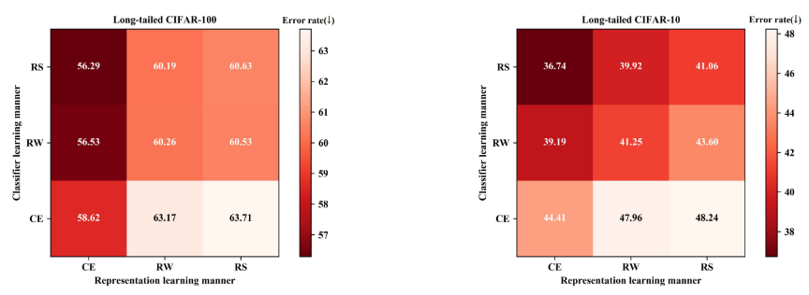
Two-Stage Re-balancing
Drawbacks of conventional re-balancing:
Foreknowledge towards the data: knowing the future data distribution before learning
Under-fitting to the head
Over-fitting to the tail
[3] BBN: Bilateral-Branch Network with Cumulative Learning for Long-Tailed Visual Recognition, CVPR 2020

Slide 15
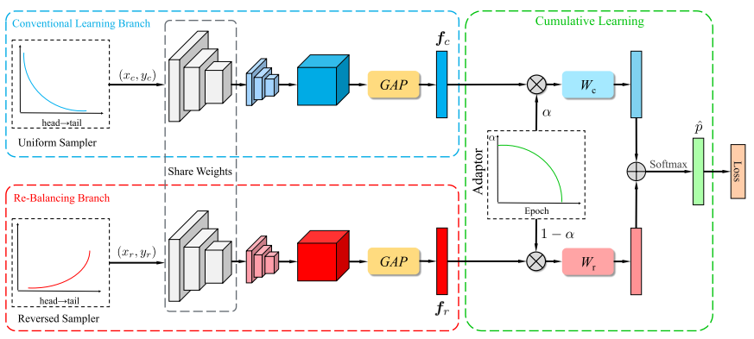
Two-Stage Re-balancing
The two-stage solutions for the above drawbacks:
Smoothly adapted bilateral-branch training [3]
Decoupled two-stage training [4]
long-tailed data
balanced data
CNN
Backbone
CNN
Backbone
Classifier
Classifier
Stage 1
Stage 2
[3] BBN: Bilateral-Branch Network with Cumulative Learning for Long-Tailed Visual Recognition, CVPR 2020
[4] Decoupling Representation and Classifier for Long-Tailed Recognition, ICLR 2020

Slide 16
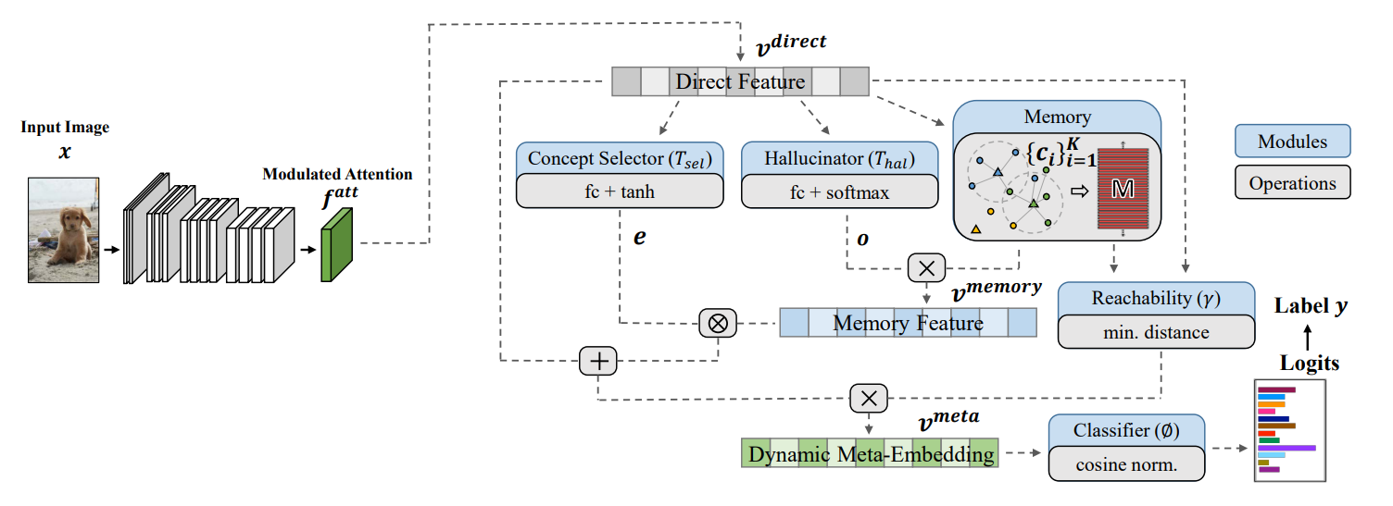
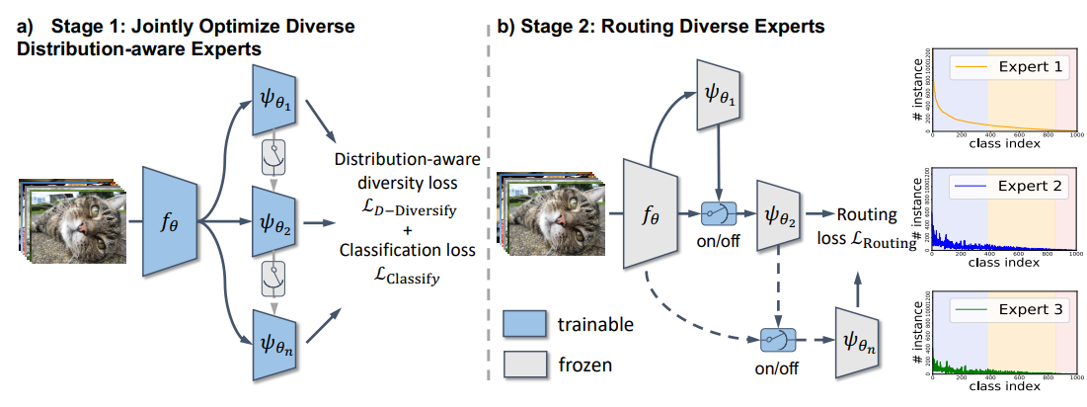
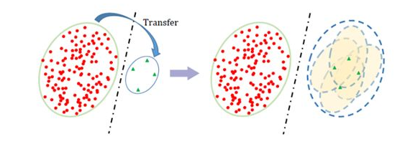
Other Approaches
Transfer Learning
Transfer head knowledge to tail classes [5]
Memory module [6]
Ensemble
Multiple experts with diverse loss [7]
[5] Liu, Jialun, et al. "Deep Representation Learning on Long-tailed Data: A Learnable Embedding Augmentation Perspective." CVPR. 2020.
[6] Liu, Ziwei, et al. "Large-scale long-tailed recognition in an open world." CVPR. 2019.
[7] Wang, Xudong, et al. "Long-tailed Recognition by Routing Diverse Distribution-Aware Experts." arXiv preprint arXiv:2010.01809 (2020).

Slide 17

They fail to explain the whys and wherefores of their solutions:
Back To The Two-Stage SOTAs
What’s the problem of existing two-stage solutions?
why is the re-balanced classifier good but the re-balanced feature learning bad?
why does the two-stage training significantly outperform the end-to-end one in long-tailed classification?

Slide 18
Contents
Long-Tailed Classification
Related Work
The Proposed Causal Graph
De-confound TDE
Advantages
Experiments

Slide 19
We should not blame the dataset
We, human beings, also live in a long-tailed world.
The problem must reside in the learning framework.
Head Classes
(Most of the data)
Tail Classes (Most of the categories)

Slide 20
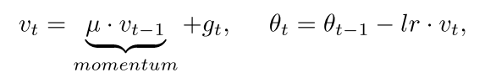
Accumulative Momentum Effect
The PyTorch implementation of SGD with momentum [8]:
The moving average momentum will encode the data distribution, that creates a shortcut towards the head.
[8] https://pytorch.org/docs/stable/_modules/torch/optim/sgd.html

Slide 21
Accumulative Momentum Effect
SGD Momentum in
Balanced Dataset
SGD Momentum in
Long-Tailed Dataset
Global Optima for All Categories
Local Optima for Head Categories
Momentum Direction in Balanced Data
Momentum Direction in Long-Tailed Data

Slide 22
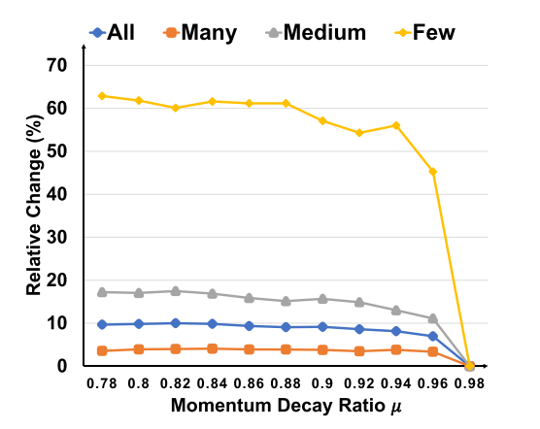
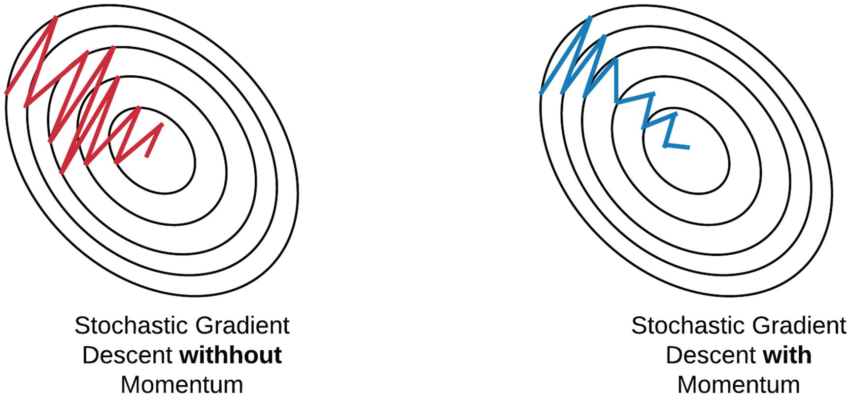
Accumulative Momentum Effect
The PyTorch implementation of SGD with momentum [8]:
[8] https://pytorch.org/docs/stable/_modules/torch/optim/sgd.html

Slide 23
Causal Effect of Momentum
Why not remove the momentum when training the
long-tailed dataset?
Remove Momentum:
Unstable Gradient
Local Optima
SGD Still Accumulates
Keep Momentum in Training
Remove Bad Causal Effect

Slide 24
Causal Graph of momentum
M
X : Feature
Y : Prediction
M: Momentum
D : Projection on Head
D
X
Y

Slide 25
The Proposed Causal Graph
M
X : Feature
Y : Prediction
M: Momentum
D : Projection on Head
D
X
Y

Slide 26
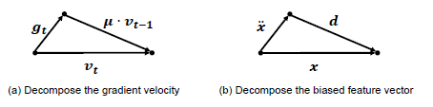
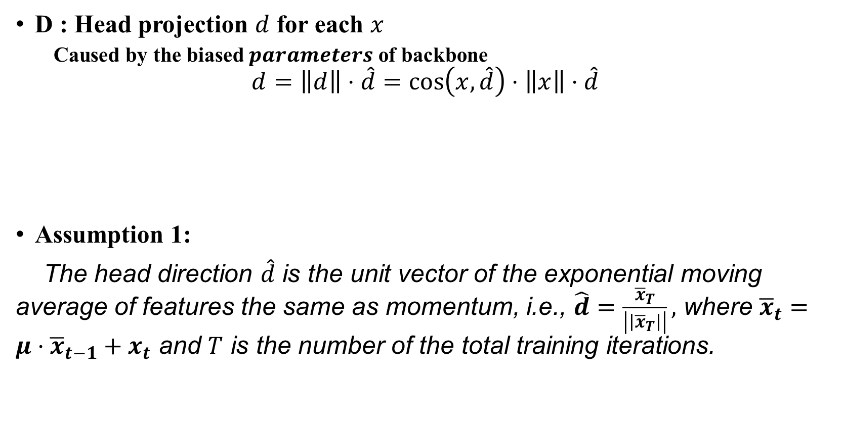
The Proposed Causal Graph
D : Head projection $d$ for each $x$
Caused by the biased $parameters$ of backbone
$$d=\left\|d\right\|⋅\hat{d}=\cos\left(x,\hat{d}\right)⋅\left\|x\right\|⋅\hat{d}$$
Assumption 1:
The head direction $\hat{d}$ is the unit vector of the exponential moving average of features the same as momentum, i.e., $\hat{d}=\frac{{\overline{x}}_{T}}{\left|\left|{\overline{x}}_{T}\right|\right|},$ where ${\overline{x}}_{t}=μ⋅{\overline{x}}_{t−1}+x_{t}$ and $T$ is the number of the total training iterations.

Slide 27
The Proposed Causal Graph
M
X : Feature
Y : Prediction
M: Momentum
D : Projection on Head
D
X
Y
Notes:
M will change the para of backbone, which determine the value of X
Due to the M effect, X will be deviated to the head direction,
which eventually cause the bias in Y

Slide 28
Two Undesired Causal Effects of Momentum
M
Two Undesired Causal Effects of Momentum：
Backdoor shortcut
Indirect Mediator Effect
D
X
Y
Notes:
There are two XXXXXX

Slide 29



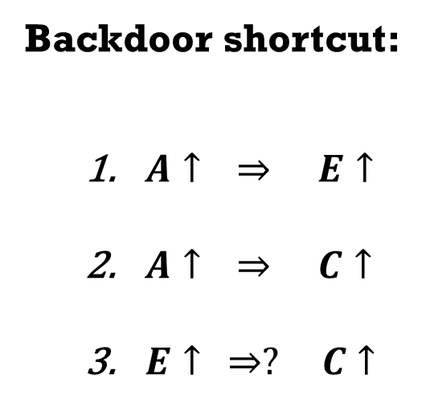
Confounder and backdoor shortcut
Backdoor shortcut:
$A↑ ⇒ E↑$
$A↑ ⇒ C↑$
$E↑ ⇒? C↑$
A
E
C
Backdoor shortcut
A: age E: exercise C: cancer

Slide 30

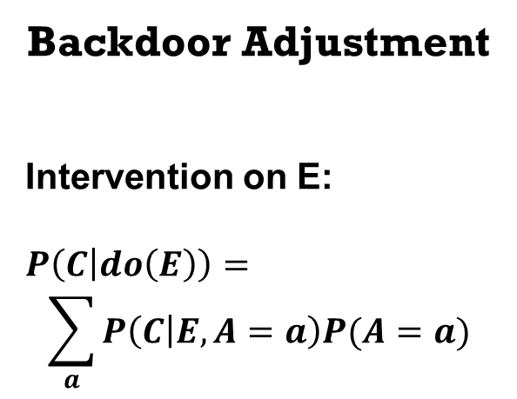
backdoor Adjustment
Backdoor Adjustment
Intervention on E:
$$P\left(C | do\left(E\right)\right)=$$
$$\sum_{a}{P\left(C | E,A=a\right)P(A=a)}$$
A
E
C
A: age E: exercise C: cancer

Slide 31
Two Undesired Causal Effects of Momentum
M
Two Undesired Causal Effects of Momentum：
Backdoor shortcut
Indirect Mediator Effect
D
X
Y

Slide 32
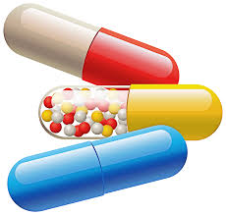


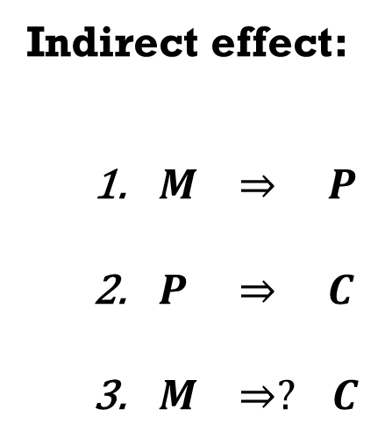
Mediator and indirect effect
Indirect effect:
$M ⇒ P$
$P ⇒ C$
$M ⇒? C$
P
M
C
M: medicine P: placebo C: cure

Slide 33
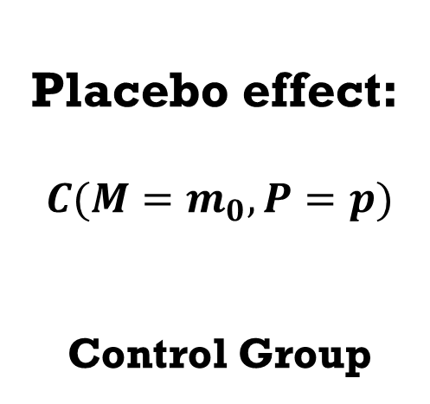
Removing Placebo effect
Placebo effect:
$$C(M=m_{0}, P=p)$$
Control Group
P
M
C
M: medicine P: placebo C: cure

Slide 34
Contents
Long-Tailed Classification
Related Work
The Proposed Causal Graph
De-confound TDE
Advantages
Experiments

Slide 35
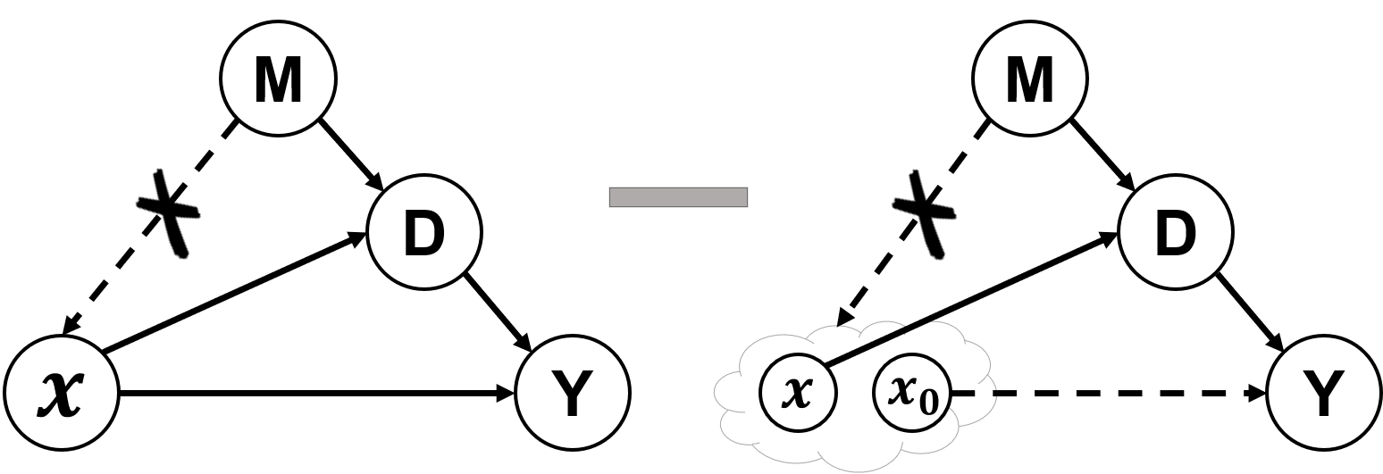
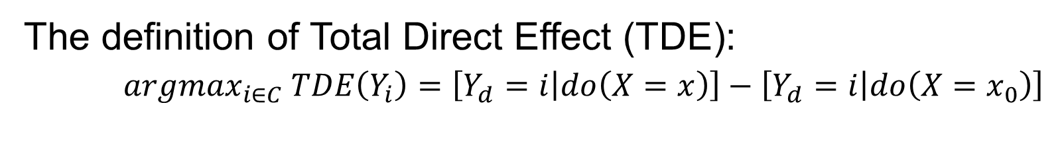
De-confound TDE Classifier
The definition of Total Direct Effect (TDE):
$argmax_{i∈C} TDE\left(Y_{i}\right)=\left[Y_{d}=i | do\left(X=x\right)\right]−\left[Y_{d}=i | do\left(X=x_{0}\right)\right]$
The proposed classifier = De-confounded Training + TDE Inference

Slide 36
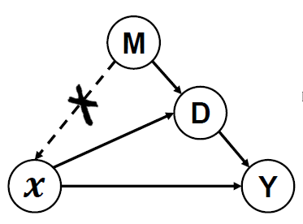
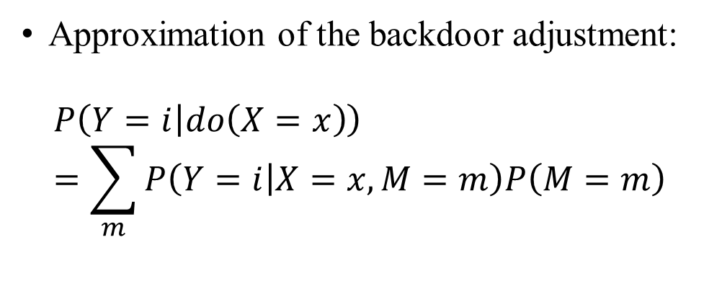
De-confounded training (An Open Question)
Approximation of the backdoor adjustment:
$$P\left(Y=i | do\left(X=x\right)\right)$$
$$=\sum_{m}{P\left(Y=i | X=x, M=m\right)P\left(M=m\right)}$$
Inverse Probability Weighting [8]:
Skip the prohibitive P(M)
Applying the propensity score to reduce the confounding effects [9]
[8] Judea Pearl, et.al., Causal inference in statistics: A primer. 2016.
[9] Austin, Peter C. "An introduction to propensity score methods for reducing the effects of confounding in observational studies." Multivariate behavioral research.

Slide 37
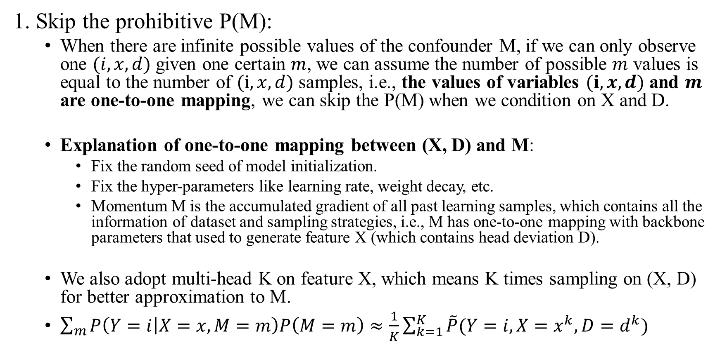
Inverse Probability Weighting
1. Skip the prohibitive P(M):
When there are infinite possible values of the confounder M, if we can only observe one $(i,x,d)$ given one certain $m$, we can assume the number of possible $m$ values is equal to the number of $(i,x,d)$ samples, i.e., the values of variables $(i,x,d)$ and $m$ are one-to-one mapping, we can skip the P(M) when we condition on X and D.
Explanation of one-to-one mapping between (X, D) and M:
Fix the random seed of model initialization.
Fix the hyper-parameters like learning rate, weight decay, etc.
Momentum M is the accumulated gradient of all past learning samples, which contains all the information of dataset and sampling strategies, i.e., M has one-to-one mapping with backbone parameters that used to generate feature X (which contains head deviation D).
We also adopt multi-head K on feature X, which means K times sampling on (X, D) for better approximation to M.
$\sum_{m}{P\left(Y=i | X=x, M=m\right)P\left(M=m\right)}≈\frac{1}{K}\sum_{k=1}^{K}{\tilde{P}(Y=i,X=x^{k},D=d^{k})}$

Slide 38
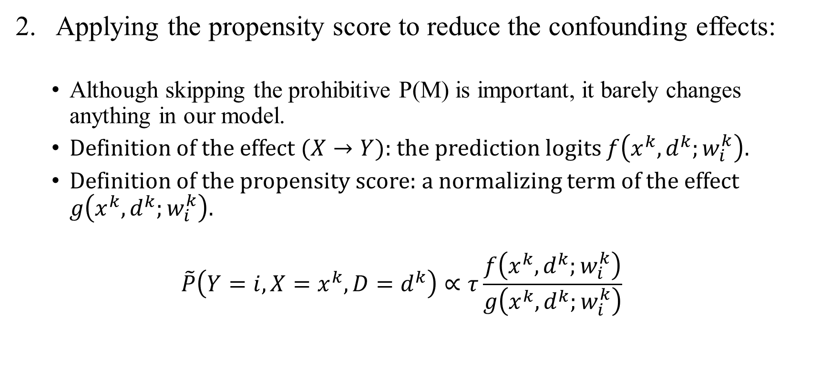
Inverse Probability Weighting
Applying the propensity score to reduce the confounding effects:
Although skipping the prohibitive P(M) is important, it barely changes anything in our model.
Definition of the effect ($X→Y$): the prediction logits $f\left(x^{k},d^{k};w_{i}^{k}\right)$.
Definition of the propensity score: a normalizing term of the effect $g\left(x^{k},d^{k};w_{i}^{k}\right)$.
$$\tilde{P}\left(Y=i,X=x^{k},D=d^{k}\right)∝τ\frac{f\left(x^{k},d^{k};w_{i}^{k}\right)}{g\left(x^{k},d^{k};w_{i}^{k}\right)}$$

Slide 39
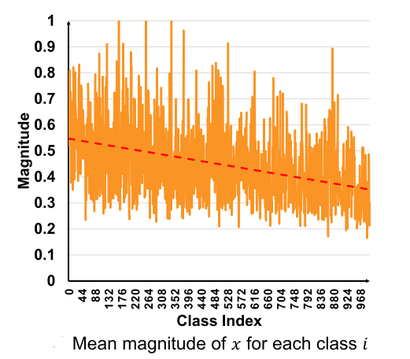
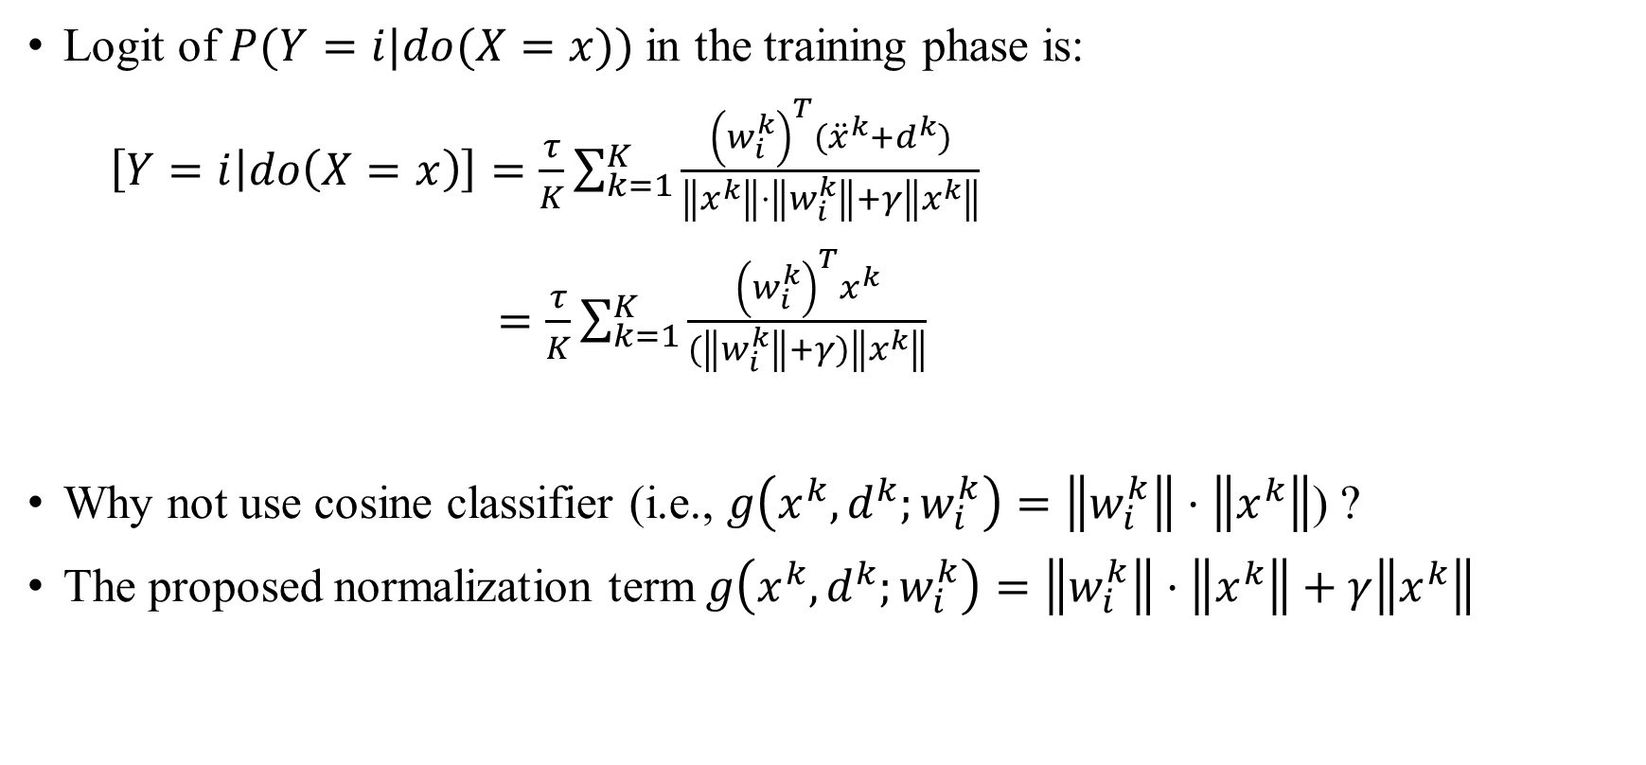
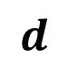
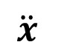
De-confounded Training
Logit of $P(Y=i|do(X=x))$ in the training phase is:
$\left[Y=i | do\left(X=x\right)\right]=\frac{τ}{K}\sum_{k=1}^{K}{\frac{{\left(w_{i}^{k}\right)}^{T}({\ddot{x}}^{k}+d^{k})}{\left\|x^{k}\right\|⋅\left\|w_{i}^{k}\right\|+γ\left\|x^{k}\right\|}}$
$=\frac{τ}{K}\sum_{k=1}^{K}{\frac{{\left(w_{i}^{k}\right)}^{T}x^{k}}{(\left\|w_{i}^{k}\right\|+γ)\left\|x^{k}\right\|}}$
Why not use cosine classifier (i.e., $g\left(x^{k},d^{k};w_{i}^{k}\right)=\left\|w_{i}^{k}\right\|⋅\left\|x^{k}\right\|$) ?
The proposed normalization term $g\left(x^{k},d^{k};w_{i}^{k}\right)=\left\|w_{i}^{k}\right\|⋅\left\|x^{k}\right\|+γ\left\|x^{k}\right\|$
$$d$$
$$\ddot{x}$$

Slide 40
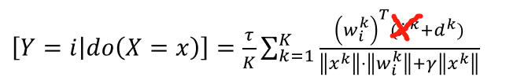
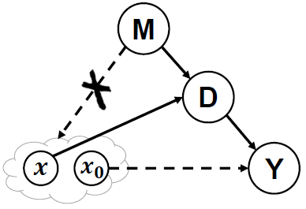
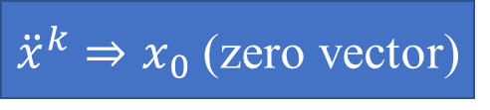
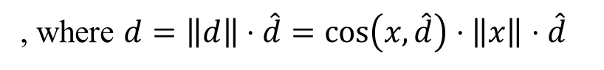
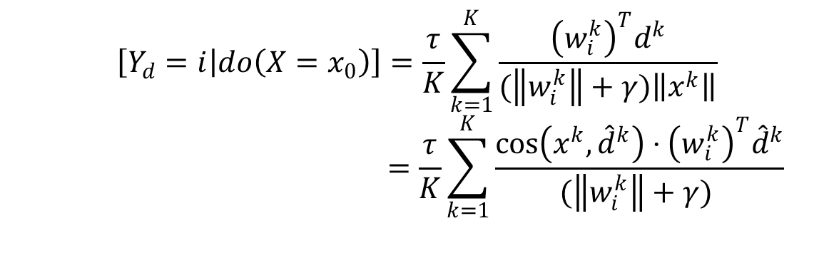
The Counterfactual Bias (Placebo Effect)
${\ddot{x}}^{k}⇒x_{0}$ (zero vector)
$$\left[Y_{d}=i | do\left(X=x_{0}\right)\right]=\frac{τ}{K}\sum_{k=1}^{K}{\frac{{\left(w_{i}^{k}\right)}^{T}d^{k}}{(\left\|w_{i}^{k}\right\|+γ)\left\|x^{k}\right\|}}$$
$$=\frac{τ}{K}\sum_{k=1}^{K}{\frac{{\cos\left(x^{k},{\hat{d}}^{k}\right)⋅\left(w_{i}^{k}\right)}^{T}{\hat{d}}^{k}}{(\left\|w_{i}^{k}\right\|+γ) }}$$
, where $d=\left\|d\right\|⋅\hat{d}=\cos\left(x,\hat{d}\right)⋅\left\|x\right\|⋅\hat{d}$

Slide 41
De-confound TDE Inference
$$TDE\left(Y_{i}\right)=\frac{τ}{K}\sum_{k=1}^{K}{(\frac{{\left(w_{i}^{k}\right)}^{T}x^{k}}{\left(\left\|w_{i}^{k}\right\|+γ\right)\left\|x^{k}\right\|}−α⋅\frac{{\cos\left(x^{k},{\hat{d}}^{k}\right)⋅\left(w_{i}^{k}\right)}^{T}{\hat{d}}^{k}}{(\left\|w_{i}^{k}\right\|+γ) })}$$

Slide 42
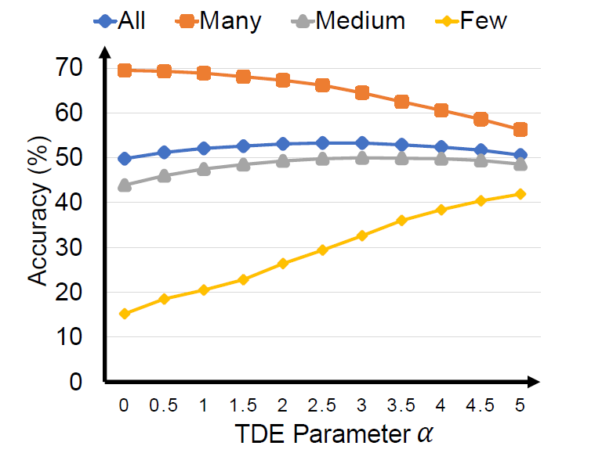
How D Affects the Performance
Experiments on ImageNet-LT Val

Slide 43
Contents
Long-Tailed Classification
Related Work
The Proposed Causal Graph
De-confound TDE
Advantages
Experiments

Slide 44
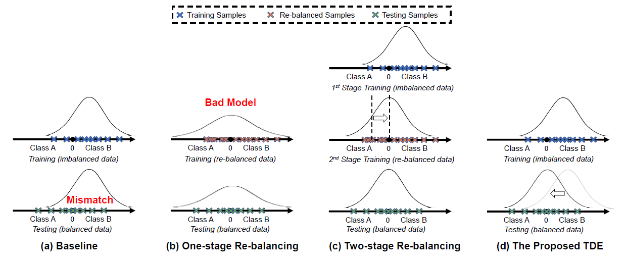
A Simple Example

Slide 45
Advantages
The proposed de-confound TDE simple, adaptive, and agnostic to the prior statistics of the class distribution:
It doesn’t introduce any additional stages or modules.
It can be applied to a variety of tasks, including but not limited to image classification, object detection, instance segmentation.
It doesn’t rely on the accessibility of data distribution.

Slide 46
Contents
Long-Tailed Classification
Related Work
The Proposed Causal Graph
De-confound TDE
Advantages
Experiments

Slide 47
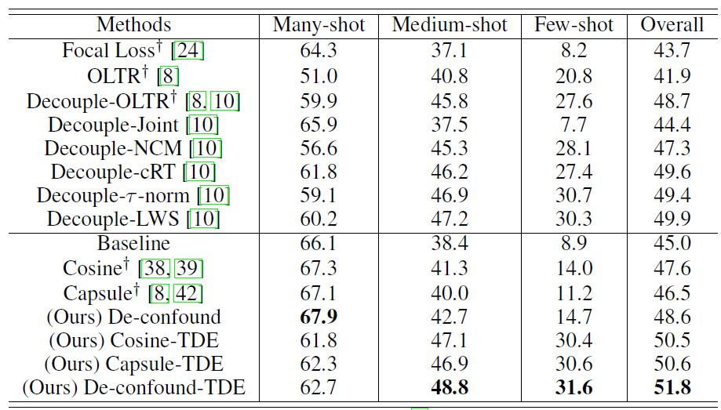

Image Classification: ImageNet-LT
Experiments on ImageNet-LT
Cosine Classifier:
$g\left(x^{k},d^{k};w_{i}^{k}\right)$
= $\left\|x^{k}\right\|⋅\left\|w_{i}^{k}\right\|$
Capsule Classifier:
$g\left(x^{k},d^{k};w_{i}^{k}\right)$
= $\left\|x^{k}\right\|⋅\left\|w_{i}^{k}\right\|+\left\|w_{i}^{k}\right\|$

Slide 48

Image Classification: ImageNet-LT
Does the improvement come from multi-head trick?

Slide 49

Image Classification: ImageNet-LT
Will the improvement be consistent across different backbones?

Slide 50

Image Classification: ImageNet-LT
How we select hyper-parameters based on ImageNet-LT Val:

Slide 51

Image Classification: Long-Tailed CIFAR
Will the improvement be consistent across different imbalance ratio?

Slide 52

Detection & Instance Segmentation
Experiment Results on LVIS V0.5/V1.0 Val

Slide 53



Background-Exempted Inference (Trick)
Background-Exempted Inference (when there are good heads):
where $i=0$ is the background category, $p_{i}=P\left(Y=i|do(X=x)\right)$, $q_{i}$ is the probability of original $TDE$.

Slide 54

Detection & Instance Segmentation
Experiments on LVIS V0.5 with Different Backbones

Slide 55

Grad-cam Visualization on ImageNet-LT
What does our model see from images?

Slide 56


Thank You
Code Link
Paper Link

